Slide 1

Distributed version control with Git
Part 2:
Working with remotes
Daniel Sussman
https://gitlab.com/dmsussman/workingWithGit/

Slide 2
In part 1 we had a repository...
HEAD
master
C0
C1
C4
C6
C2
C3
C5
latexBranch
It was amazing...

Slide 3
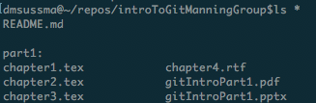
Since then, I’ve put the files and slides in a subdirectory...

Slide 4
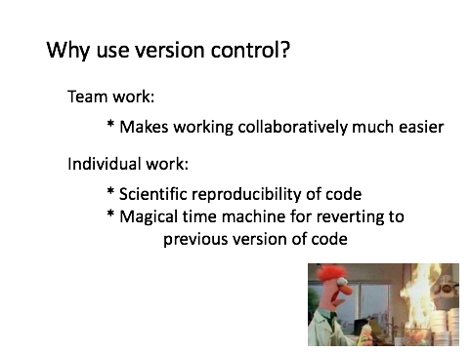
Just working locally is good...
but it isn’t very distributed...
Remote repositories will help achieve some of these aims

Slide 5
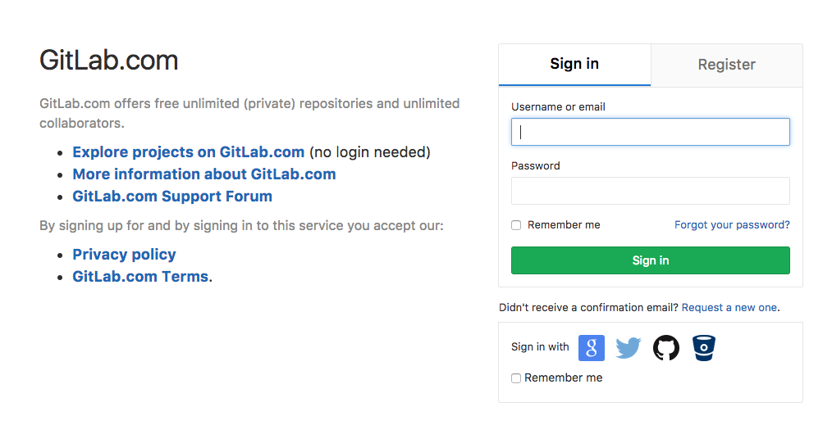
Step 0: Make a GitLab account
GitLab – an open source, web-based git repository manager
Alternatives: GitHub, BitBucket...
This – and all other screenshots in the presentation – are from Sept. 13, 2017.

Slide 6
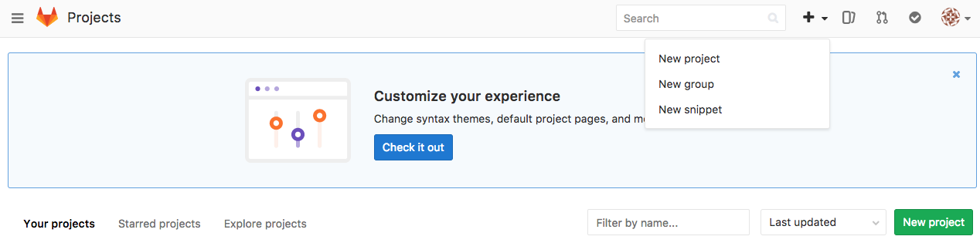
Let’s set up a new project
“Project” being code for “repository”
Two great options for where to click

Slide 7
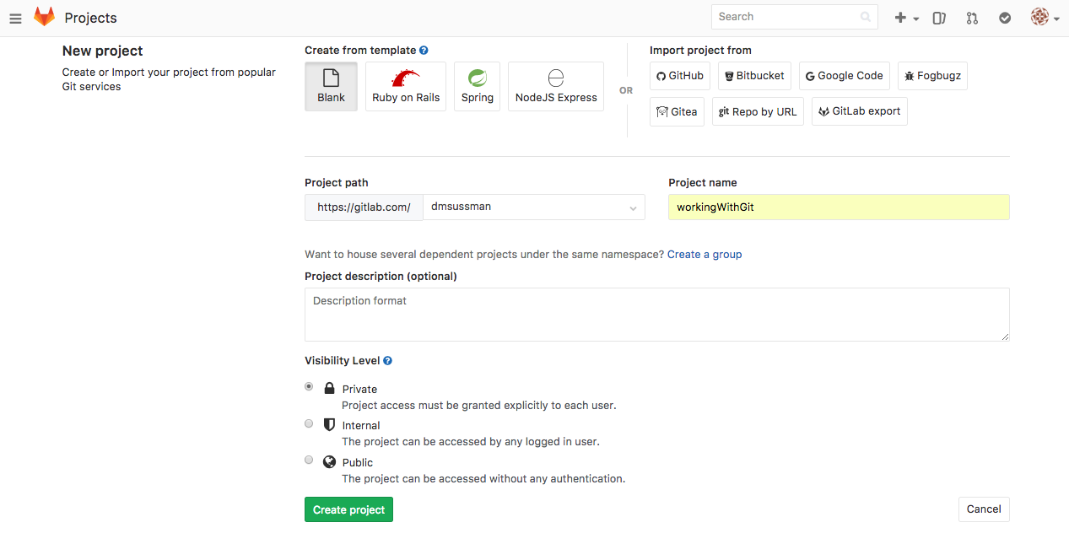
Let’s set up a new project

Slide 8
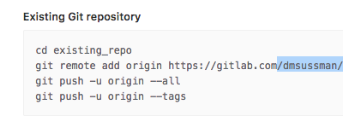
And push our existing
repository to the cloud!
Assuming we’re already in the project directory:
$ git remote add origin https://gitlab.com/dmsussman/workingWithGit.git
$ git push –u origin --all
GitLab provides step by step instructions for exactly this
Comment: google any git-related question, and you will find the answer

Slide 9
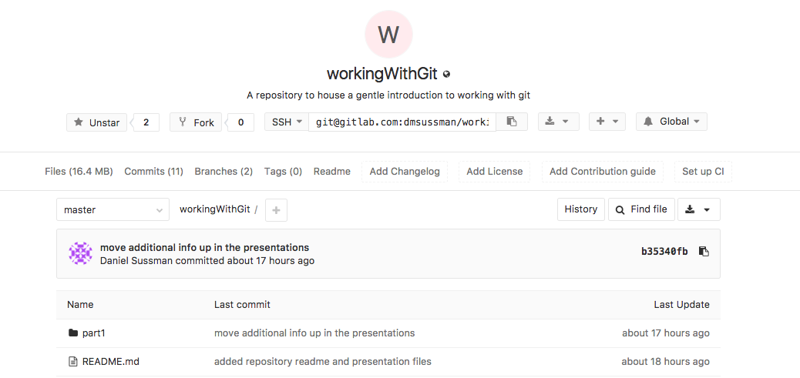
There is now an equivalent repository...in the cloud!

Slide 10
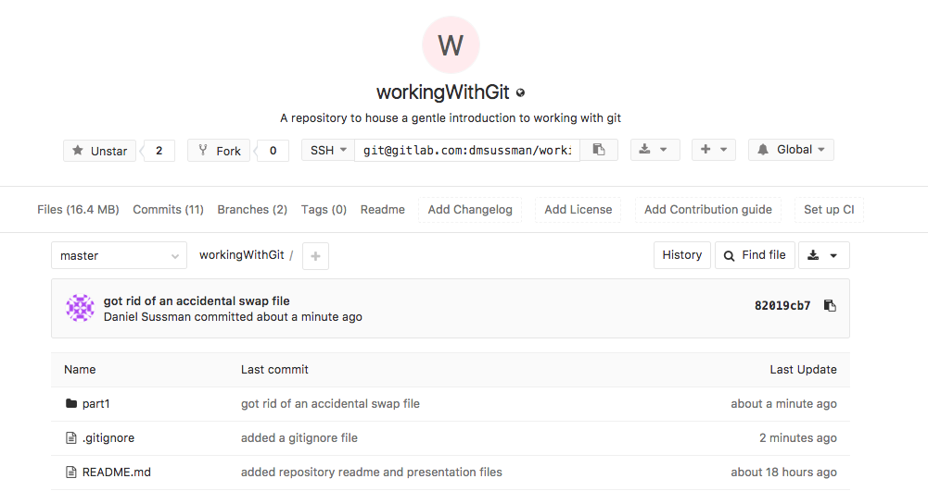
Let’s make a change and git push it
Specifies untracked files or patterns of files to ignore
$ vim .gitignore
$ git add .
$ git commit –m “added a gitignore file”
$git push
Before
After

Slide 11
Getting new local copies: git clone
It is easy to clone new copies:
$ git clone https://gitlab.com/dmsussman/workingWithGit.git
newDirectory
This copies the repository at the specified location and puts it in a new directory (called, in this case “newDirectory”)
Work on multiple machines, use as a backup, ...

Slide 12
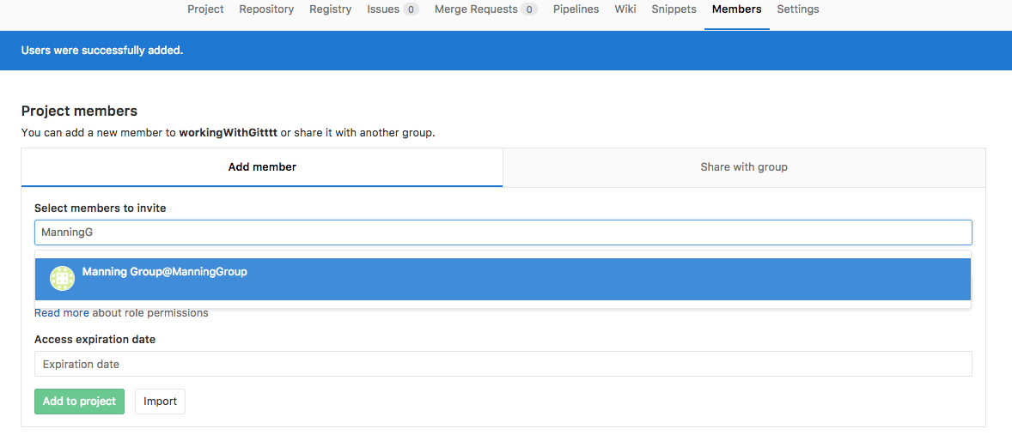
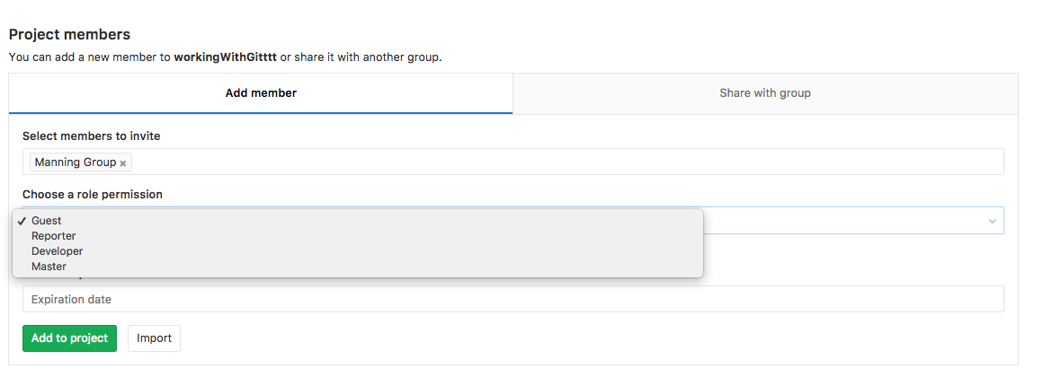
Let’s get collaborative!
Staniel Sussman
Staniel Sussman
Staniel Sussman
I’ll add him as a “Master”, which gives him (almost) complete access to this repository
I just searched for my friend, “Staniel Sussman” and added him to the project

Slide 13
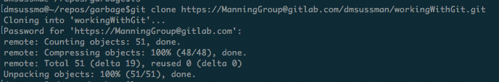
Staniel git clones the repository
Plot twist: “Staniel Sussman” is also me, using the Manning Group GitLab account.
Three independent but linked copies
GitLab
Daniel
Staniel

Slide 14
Staniel edits the repository
$ mkdir part2
$ vim part2/file1.txt
$ git add .
$ git commit -m "starting part2"
GitLab
Daniel
Staniel

Slide 15
Staniel pushes the changes
$ git push
GitLab
Daniel
Staniel

Slide 16
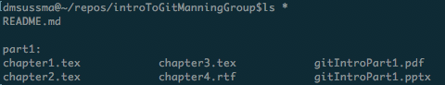
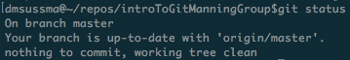
Daniel’s repository does not auto-update
GitLab
Daniel
Staniel

Slide 17
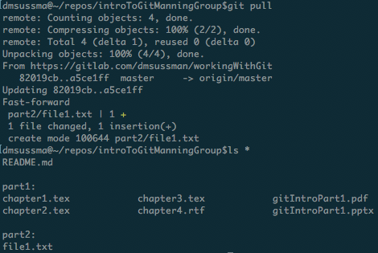
Daniel git pulls changes
from repository
$ git pull
GitLab
Daniel
Staniel

Slide 18
Managing conflicts
Suppose:
(1) Staniel edits a file and pushes the changes
(2) Daniel edits the same file without pulling
(3) Daniel tries to push his changes?

Slide 19
Managing conflicts
Suppose:
(1) Staniel edits a file and pushes the changes
(2) Daniel edits the same file without pulling
(3) Daniel tries to push his changes?
$ vim part2/file1.txt
$ git add .
$ git commit -m “file1 in part2 edited by Stan”
$ git push

Slide 20
Managing conflicts
Suppose:
(1) Staniel edits a file and pushes the changes
(2) Daniel edits the same file without pulling
(3) Daniel tries to push his changes?
$ vim part2/file1.txt
$ git add .
$ git commit -m “file1 in part2 edited by Dan”

Slide 21
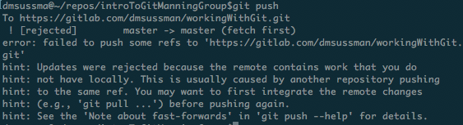
Managing conflicts
Suppose:
(1) Staniel edits a file and pushes the changes
(2) Daniel edits the same file without pulling
(3) Daniel tries to push his changes?
$ git push

Slide 22
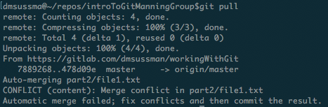
Managing conflicts
Suppose:
(1) Staniel edits a file and pushes the changes
(2) Daniel edits the same file without pulling
(3) Daniel tries to pull?
$ git pull

Slide 23
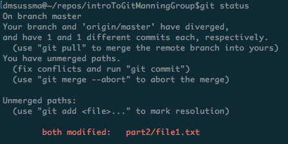
Managing conflicts
Suppose:
(1) Staniel edits a file and pushes the changes
(2) Daniel edits the same file without pulling
(3) Daniel checks the status?
$ git status

Slide 24
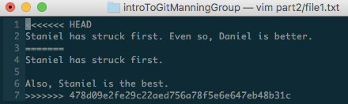
Managing conflicts
Suppose:
(1) Staniel edits a file and pushes the changes
(2) Daniel edits the same file without pulling
(3) Daniel looks at that file?
$ vim part2/file1.txt

Slide 25
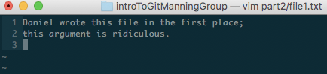
Managing conflicts
Suppose:
(1) Staniel edits a file and pushes the changes
(2) Daniel edits the same file without pulling
(3) Daniel resolves the conflict however he wants
$ vim part2/file1.txt

Slide 26
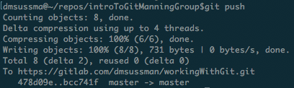
Managing conflicts
Suppose:
(1) Staniel edits a file and pushes the changes
(2) Daniel edits the same file without pulling
(3) Daniel pushes the changes to the repository
$ git add .
$ git commit -m "conflict managed"
$ git push

Slide 27
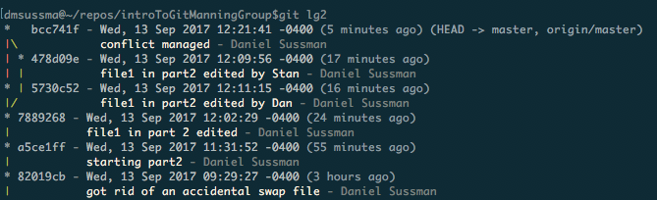
Managing conflicts
All of the attempted commits, even the one Daniel couldn’t push, become part of the repository’s history...

Slide 28
...so collaborate nicely

